Slide 1
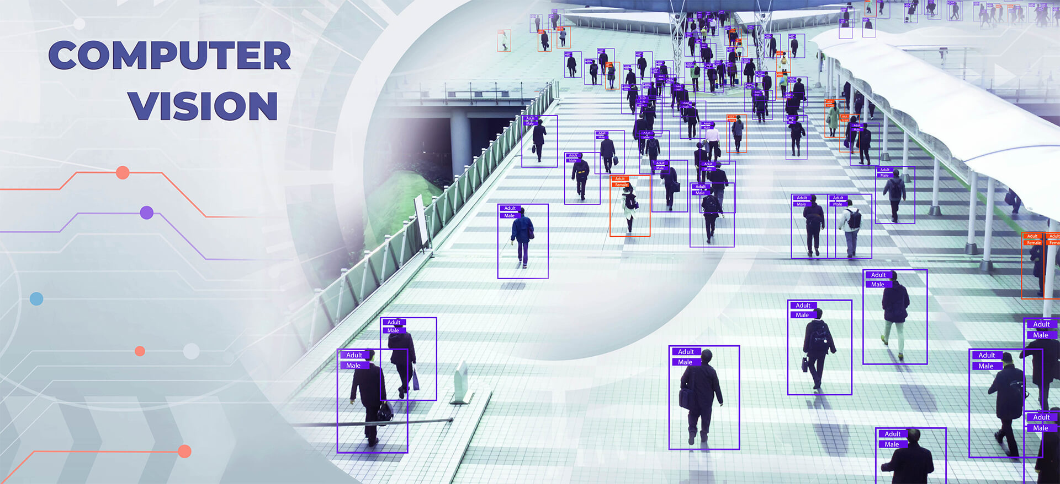

Universiter Ibn Tofail
PEOPLE COUNTER.
COMPUTER VISION
GROUP MENBERS
OUHANNOU ANAS
EL-HEZZAT AYMANE
BENKHOUYA OMAR
CHETTOU SOUHAIB

Slide 2
Introduction.
Humans always resort to classification in their lives, trying to solve problems and answer questions about categories of objects, that is, assigning objects to their classes (shapes, colors, sizes, etc.). Generally, observation bases characterize a particular domain (animals, fruits, patients, genes, etc.), where they are grouped into several classes. Automatic image classification is an application of pattern recognition, which consists of automatically assigning a class to an image using a classification system.
We thus find object classification, texture classification, face recognition, fingerprint recognition, and character recognition among common applications. Image classification allows for the categorization of an image database into several classes, such as animals, humans, transport, etc. This categorization allows for better exploitation of the database by applications such as image search for reference purposes.

Slide 3
Sommaire.
1.
4.
Data Preparation
Code
2.
5.
EXPORTING DATASET
Optimazation
3.
Model Training

Slide 4
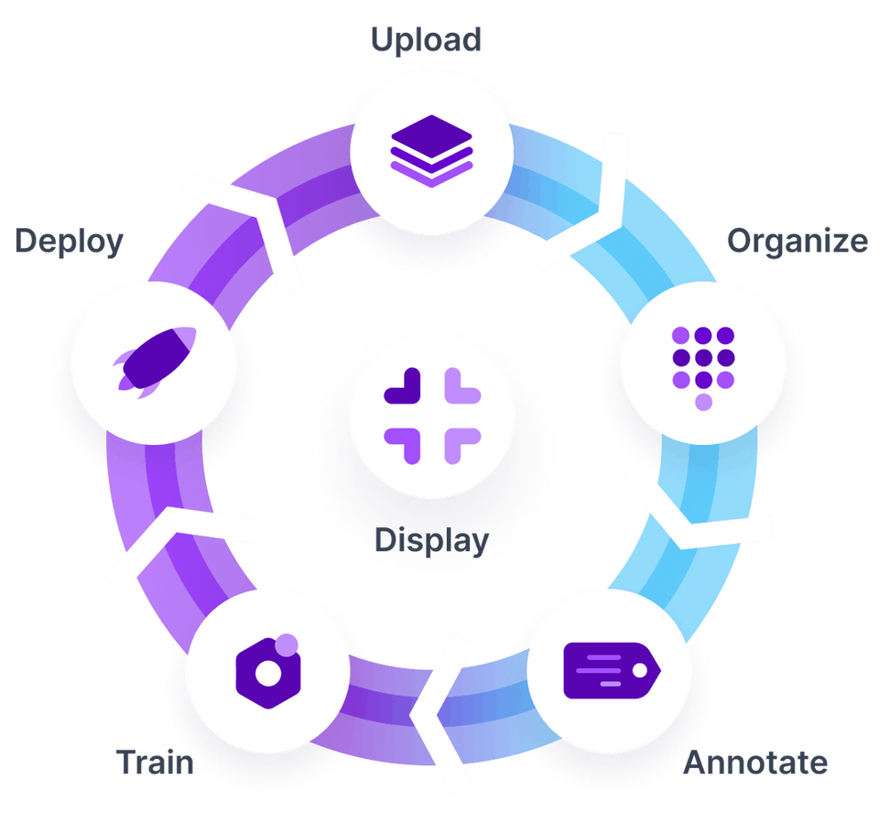

PREPARE DATA
ROBOFLOW
Roboflow is a platform designed to streamline the process of managing, preprocessing, and augmenting image datasets for computer vision applications.
Steps
Roboflow simplifies the workflow for computer vision projects through the following
steps:
Upload: Import your image dataset from various sources.
Organize: Manage and structure your dataset into relevant categories.
Annotate: Label images with bounding boxes, segmentation masks, or keypoints.
Train: Generate and preprocess datasets for training machine learning models.
Deploy: Export and integrate your trained model into production environments for
real-time inference.

Slide 5

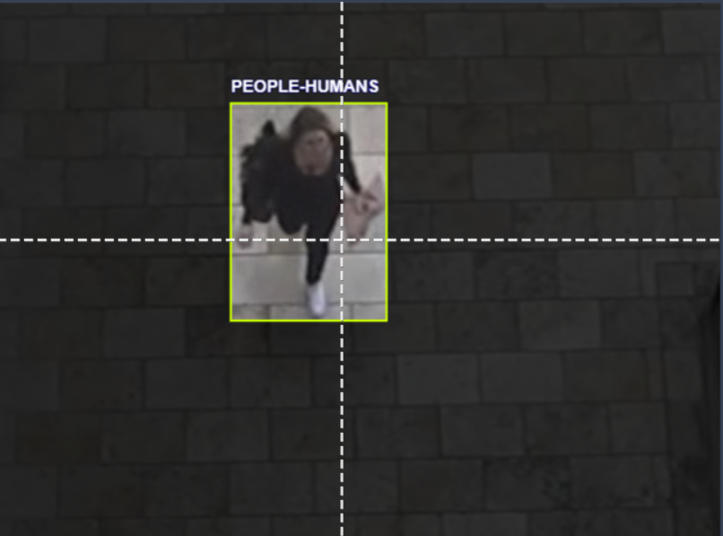

UPLOAD DATA AND ORGNIZE
POVIDING AN EXEMPLE OF OUR ANOTATION
When using Roboflow, you start by uploading your data. If you have a video file, you can upload it directly to the platform. Roboflow will automatically extract individual frames from the video. For instance, if you upload a 10-second video at 20 frames per second (fps), Roboflow will separate it into 200 frames. Once your frames are uploaded, you can move on to organizing and annotating your dataset, preparing it for training your computer vision model.

Slide 6

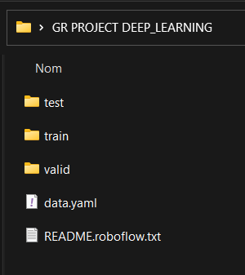
EXPORT DATASET.
EXPORTING DATA WITH ROBOFLOW
Our Exported dataset
After uploading and annotating your dataset in Roboflow, you can export it and proceed with training your model
ROBOFLOW provide different ways to train your model , you either choose to train your model with roboflow or export the data annotated and train the model by yourself
in our case, we trained our model by exporting the dataset from robotflow into google colab to train our data their. we used this methode for a better understanding of the structure of the model and training ,so we can optimize it . the picture in the right provide the structure of the exporting data from robotflow tha we will use to train our model . you can also use a deployment methode to test your model.

Slide 7
MODEL TRAINIG.
we used the code provided by ROBOFLOW .the code export the dataset after organize and annotate require your API of ur workspace name,project name and a name for your model
!mkdir {HOME}/datasets
%cd {HOME}/datasets
!pip install roboflow --quiet
from roboflow import Roboflow
rf = Roboflow(api_key="your API FROM ROBOTFLOW HERE")
project = rf.workspace("YOUR WORKSPACE NAME").project("YOUR PROJECT NAME HERE")
dataset = project.version(2).download("YOUR NAME MODEL")
Custom training :
%cd {HOME}
!yolo task=detect mode=train model=model_1.pt data=/content/datasets/PEOPLE-COUNTER-2/data.yaml epochs=25 imgsz=800 plots=True
Validate Custom Model :
%cd {HOME}
!yolo task=detect mode=val model=/content/best.pt data=/content/datasets/PEOPLE-COUNTER-2/data.yaml

Slide 8
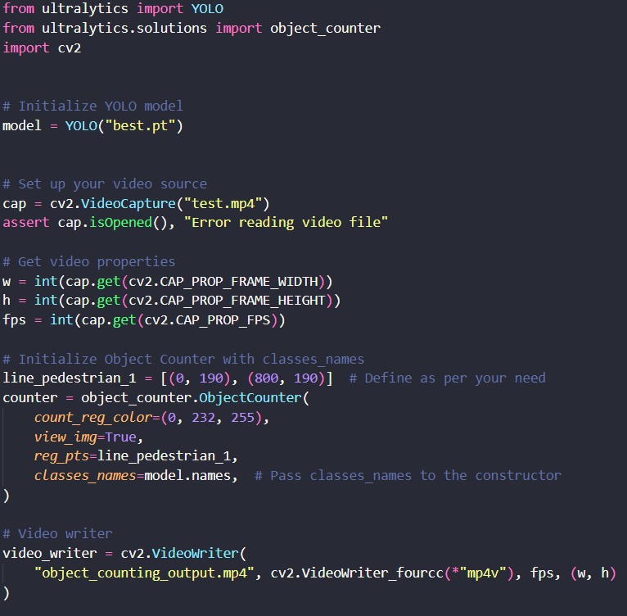
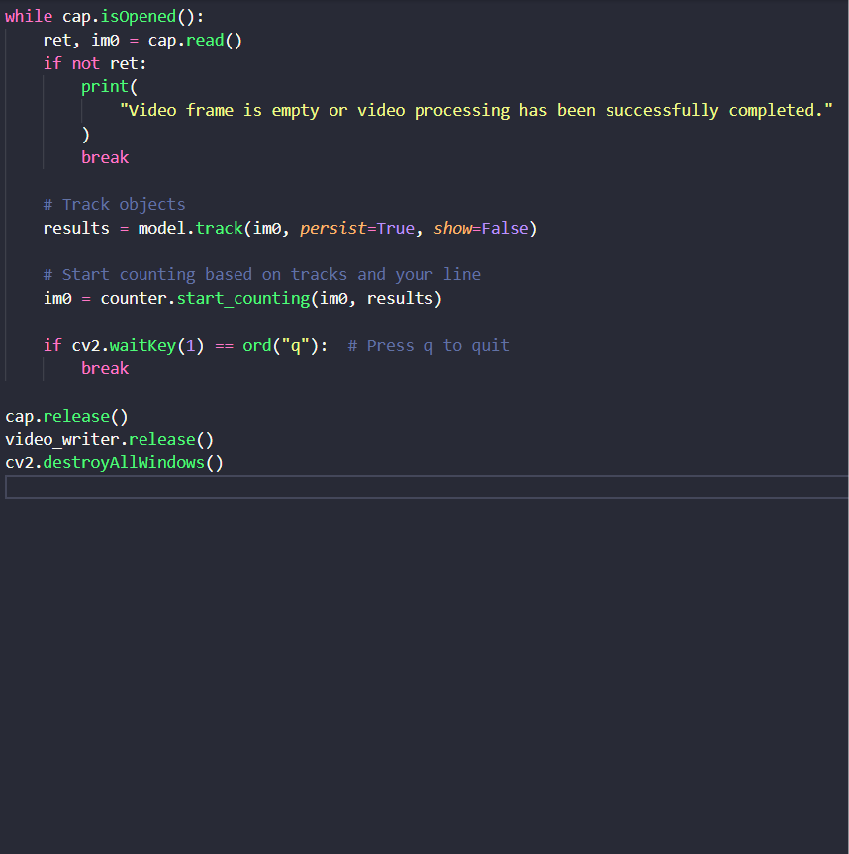
Code.

Slide 9
IMPORTANT EXPLAINATION .
In our code, we utilize the Ultralytics library to load our model and OpenCV for reading the video and writing it after preprocessing to visualize the results. For the counting process, we rely on predefined functions from the OBJECT_COUNTER module provided by Ultralytics to count people in and out, and then print the results directly onto the video. However, adjustments are required in the object_counter file to ensure precise counting.
Specifically, since the functions provided in the object_counter module do not align with the horizontal format of the video, we need to adjust the coordinates accordingly to match the video's horizontal orientation. This adjustment ensures that the counting process accurately identifies and tracks objects within the video, enhancing the overall precision of the counting mechanism.

Slide 10
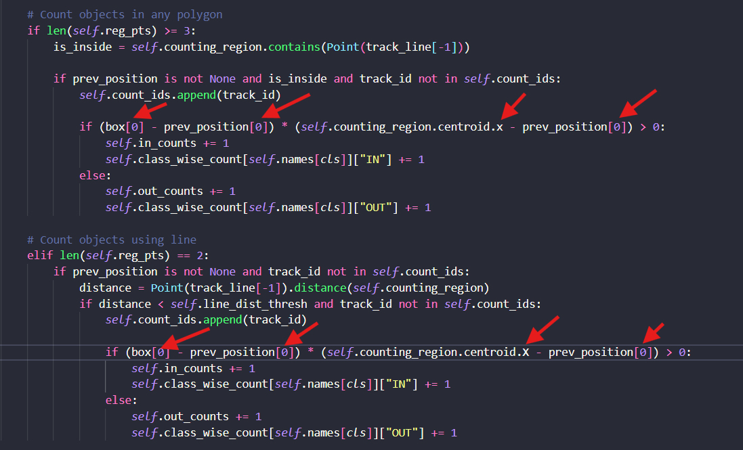
Required changes.
go to your ultralytics lib in your Desktop and browse Solutions the object_counter file should be there
these changes are important for tat the counting part can be precise

Slide 11
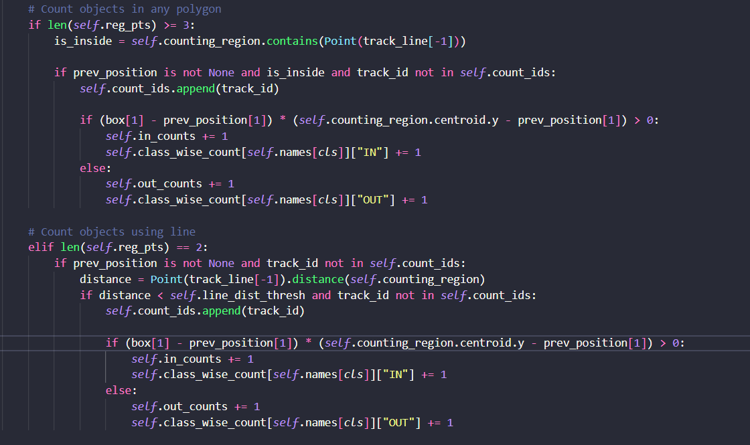
After changes.
The code should be like that after those changes

Slide 12
Tracking.
The tracking method utilized in this project, works by detecting the object using the yolov8 model . the yolov8 model provide an output layers shape that can support boundding boxes that each box contain coordinates [x_min,y_min,x_max,y_max] plus a confident score and class_id, the model can detect and track relying on the confident score ( exemple : confident_score > 0,5 can mean validate the class tracking if the score is higher than 0,5 or 50% ) then tracking the validate value and draw a box a round it ,
the line “results = model.track(im0, persist=True, show=False)”
it’s responsible for tracking as i explained it .there is bunch of methodes of tracking that we actually test some of them like cvzone ,deepsort...

Slide 13
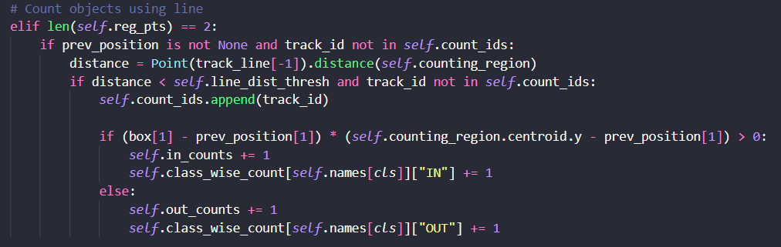
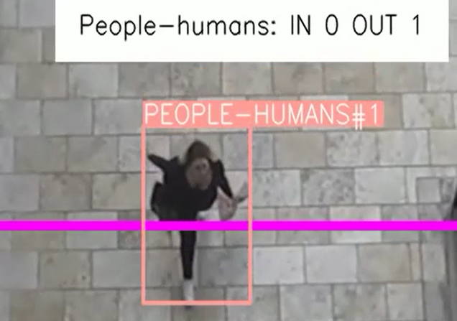
COUNTING PEOPLE.
this project, works by detecting the object using the yolov8 model, and then gives each object a unique id, thentracks the id by calculating each frame the destance between the line and the distinct object, and when the object reach the line, the function then calculate the differance between the previous position of the oject and the line and see if it is positif or negative to incriment either the out or the in count.
CODE
EXEMPLE

Slide 14
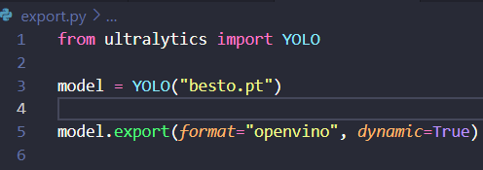
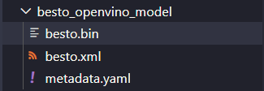
OPTIMIZATION.
To optimize model preprocessing for faster performance, various methods can be employed. If you have an NVIDIA or AMD GPU, you can use libraries like CUDA to switch from using the CPU to the GPU. However, since we are using an Intel GPU, we will utilize Intel's OpenVINO as an optimizer. there is serval ways to use openvino one of them is converting the yolo model to openvino format that will extrat from .pt model two files with an extensions .xml and .bin .
CODE TO EXPORT OPENVINO FORMAT
THE EXPORTED FOLDER AFTER RUNNING THE CODE

Slide 15
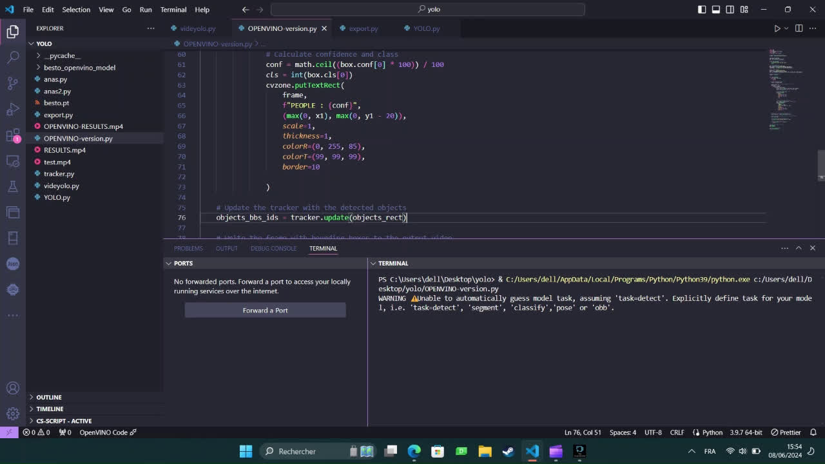
DEMOSTRATION.
the model should preprocess faster than the previous one .
(Run the demonstration video )
←

